Slide 1
AZ-100.1 Module 05: Azure Resource Manager

Slide 2
Lesson 01: Resource Groups

Slide 3
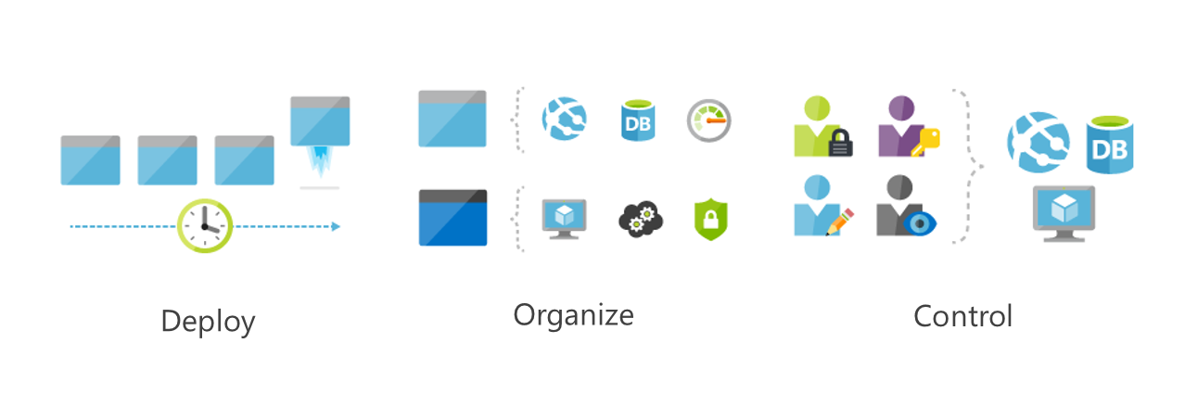
Azure Resource Manager
A resource is simply a single service instance in Azure
A resource group is a logical grouping of resources
A resource group template is a JSON file that allows you to declaratively describe a set of resources
Notes:
For more information, you can see:
Azure Resource Manager - https://docs.microsoft.com/en-us/azure/azure-resource-manager/resource-group-overview

Slide 4
Video: Azure Resource Manager
Notes:
The Azure portal interface has changed slightly since this video was recorded. However, it is still a good overview of what is available through Resource Manager.

Slide 5
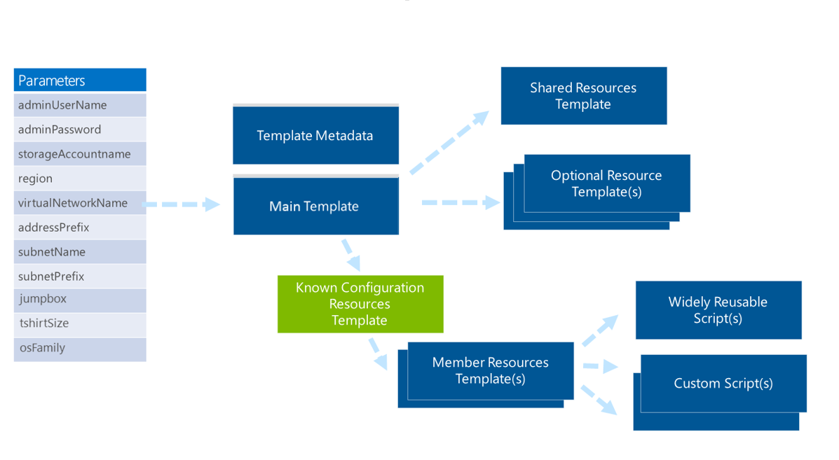
Video: ARM Templates
Notes:
As a System Administrator you will work with ARM templates every day. Although this is an older video it does a good job of explaining what ARM Templates and how they are used.

Slide 6
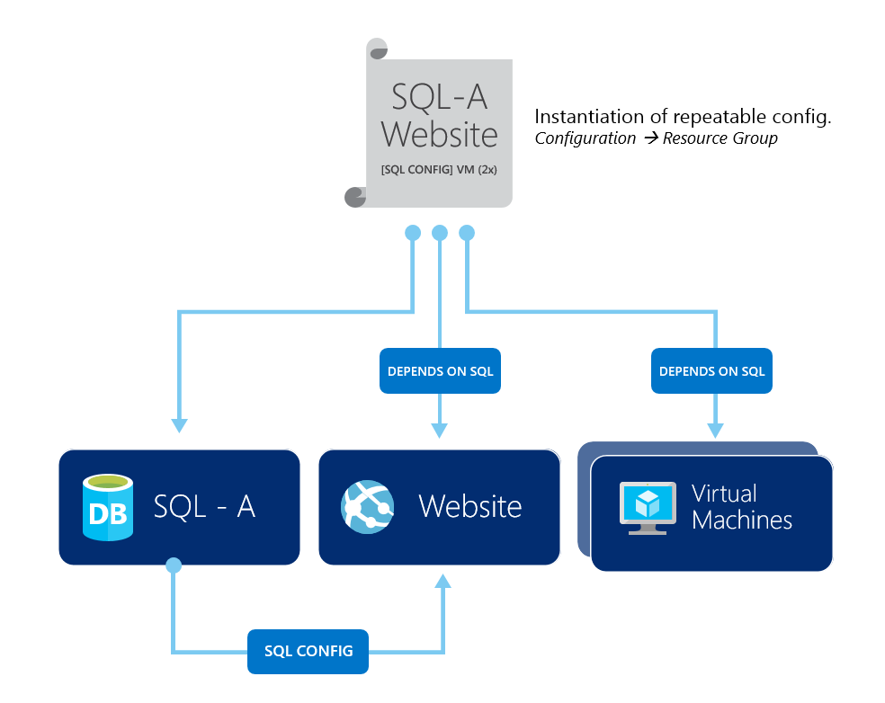
ARM Template Advantages
Ensures idempotency
Simplifies orchestration
Configure multiple resources simultaneously
Use variables/parameters/functions to create dependencies
Can be configured and managed using a source control provider
Reusable and nestable
Notes:
For more information, see:
Create a Workspace – https://docs.microsoft.com/en-us/azure/log-analytics/log-analytics-quick-collect-azurevm#create-a-workspace

Slide 7
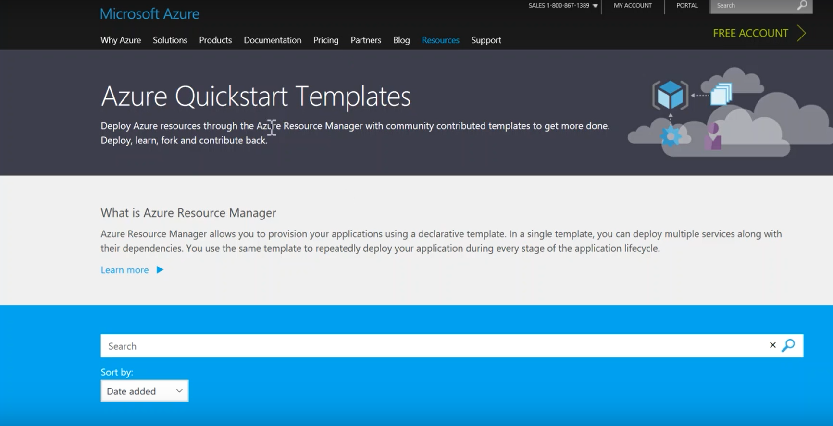
Demonstration: ARM Templates

Slide 8
Additional Practice: Deploy an ARM Template
Deploy an ARM template using PowerShell
Launch the Azure Cloud Shell
Create a resource group
Create the template files to deploy resources
Create a storage account and upload files
Deploy the template
Notes:
✔ Don’t worry about having to type the ARM template JSON code. Simply use the copy functionality that is provided in the exercise.
For more information, you can see:
Azure Resource Manager overview – https://docs.microsoft.com/en-us/azure/azure-resource-manager/resource-group-overview?toc=%2fazure%2fvirtual-machines%2fwindows%2ftoc.json
Troubleshoot common ARM deployment errors – https://docs.microsoft.com/en-us/azure/azure-resource-manager/resource-manager-common-deployment-errors

Slide 9
Lesson 02: Resource Groups

Slide 10
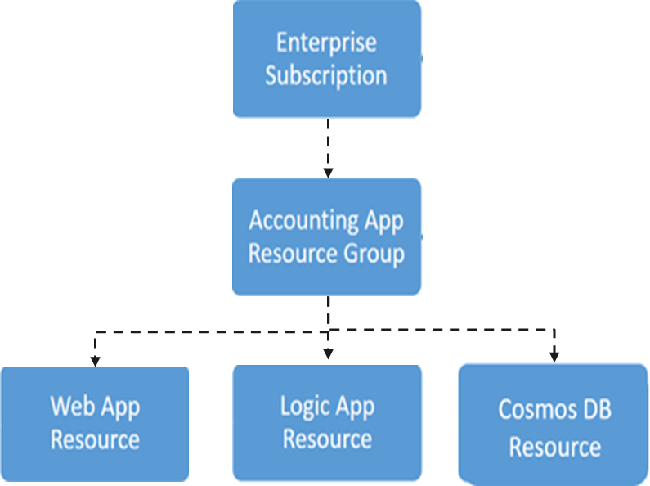
Resource Groups and Deployments
Resources can only exist in one resource group
Groups cannot be renamed
Groups can have resources of many different types (services)
Groups can have resources from many different regions
Deployments are incremental

Slide 11
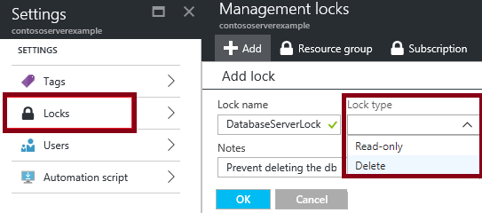
Resource Manager Locks
Associate the lock with a subscription, resource group, or resource
Locks are inherited by child resources
Read-Only locks prevent any changes to the resource.
Delete locks prevent deletion
Notes:
✔ Only Owner and User Access Administrator roles can create or delete management locks.
For additional information, see:
Lock resources to prevent unexpected changes: https://docs.microsoft.com/en-us/azure/azure-resource-manager/resource-group-lock-resources

Slide 12
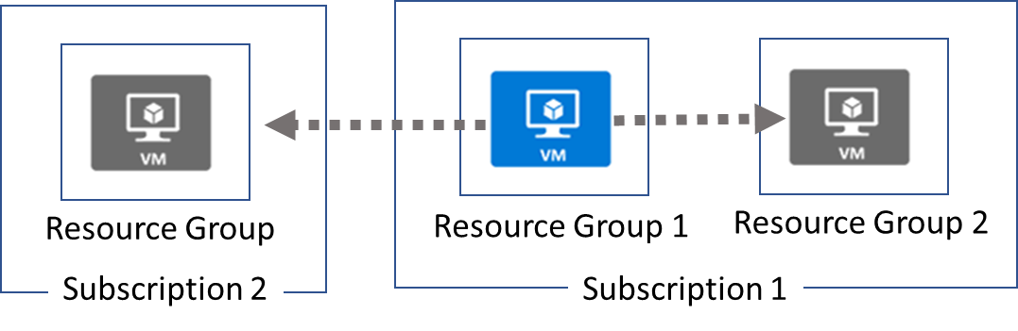
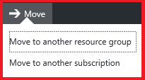
Moving Resources
When moving resources, both the source group and the target group are locked during the operation
Services that can be moved
Services that cannot be moved
Notes:
✔ Just because a service can be moved doesn’t mean there aren’t restrictions. For example, you can move a virtual network, but you must also move its dependent resources, like gateways. Learn more at the reference link.
For more information, you can see:
Move resources to new resource group or subscription - https://docs.microsoft.com/en-us/azure/azure-resource-manager/resource-group-move-resources

Slide 13

Remove Resource Groups and Resources
Resource Groups
Remove-AzureRmResourceGroup -Name "ContosoRG01"
Resources
Remove-AzureRmResource -ResourceId “ "

Slide 14
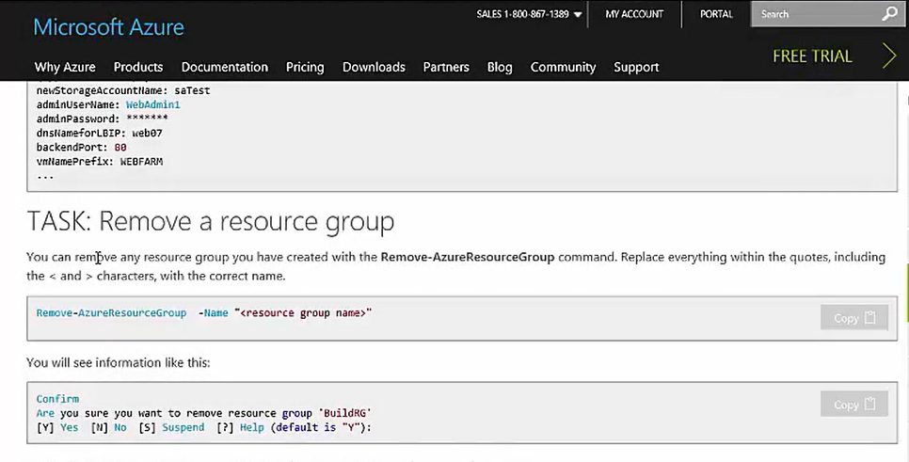
Video: Removing a Resource Group in Azure
Notes:
The Azure portal interface has changed slightly since this video was recorded. However, it is still a good overview of what is available through Resource Manager.

Slide 15
Additional Practice: Lock Resources
Lock resources to prevent unexpected changes
Add a lock for a resource using the Azure portal
Use PowerShell to
Deploy the example template
Get information about all locks on resources and resource groups
Delete a lock
Notes:
✔ To create or delete management locks, you must have access to Microsoft.Authorization/* or Microsoft.Authorization/locks/* actions. Of the built-in roles, only Owner and User Access Administrator are granted those actions.
✔ You can also perform the same exercise with the Azure CLI if you prefer - https://docs.microsoft.com/en-us/azure/azure-resource-manager/resource-group-lock-resources#azure-cli
For more information, you can see:
Lock resources to prevent unexpected changes - https://docs.microsoft.com/en-us/azure/azure-resource-manager/resource-group-lock-resources

Slide 16
Module 5: Review Questions
You administer Azure resources for an organization. You are using Azure Resource Manager templates to deploy and manage Azure services. You need to define the Azure Resource Manager type for each of the following: Web App, SQL Database, and VM Compute instance. What type is each of the resources, and why are they divided in these types?
You are using Azure Resource Manager (ARM) templates to deploy multiple resources. What are some benefits of using ARM templates?
You need to implement Resource Manager Resource Groups. What rules exists for Resource Groups?
Notes:
Q1 Answer:
A Web App is a resource. SQL Database is a Resource. A VM Compute instance is a Resource Group. There are three primary concepts in Resource Manager:
Resource: A resource is simply a single service instance in Azure. Most services in Azure can be represented as a resource. For example, a Web App instance is a resource. An App Service Plan is also a resource. Even a SQL Database instance is a resource.
Resource Group: A resource group is a logical grouping of resources. For example, a Resource Group where you would deploy a VM compute instance may be composed of a Network Interface Card (NIC), a Virtual Machine, a Virtual Network, and a Public IP Address.
Resource Group Template: A resource group template is a JSON file that allows you to declaratively describe a set of resources. These resources can then be added to a new or existing resource group. For example, a template could contain the configuration necessary to create two API App instances, a Mobile App instance and a Document DB instance.
Q2 Answer:
A template can ensure idempotency, which from a RESTful service standpoint means that multiple identical requests produce the same results as a single request. This results in no side effects on the server, and the result of the request may differ, because the resource state has changed between requests. If you deploy an identical template to multiple resource groups, they would functionally be the same.
A template can simplify orchestration as you only need to deploy the template to deploy all your resources. Normally this would take multiple operations.
A template allows you to configure multiple resources simultaneously and use variables/parameters/functions to create dependencies between resources. For example, you can require virtual machine creation before the Web App is created because you need the public IP address for one of the Web App's settings. Another example is to require that Storage account creation before virtual machine creation so that you can place the VHDs in that storage account.
A template is a JSON file. You can manage and configure the file by using a source control provider and any continuous integration process.
Templates can parameterize input and output values, so you can reuse them across many different scenarios. Templates can also be nested so you can reuse smaller templates as part of a larger orchestration.
Q3 Answer:
Resources can only exist in one resource group.
Resource Groups cannot be renamed.
Resource Groups can have resources of many different types (services).
Resource Groups can have resources from many different regions.

